Slide 1
STOR 455 Class 17
Read: 3.3
Exercises: 3.30, 31, 48

Slide 2
Example: Pulse Rates
Response Variable:
Y =Active pulse
Predictors:
X₁ = Resting pulse
X₂ = Sex (0=M, 1=F)
Data is stored in Pulse.csv

Slide 3
Categorical Predictor
Example:
Response = Y = Active pulse
Predictor = X = Sex
Are active pulse rates related to sex? “Usual” procedure?
Two-sample t-test (difference in means)

Slide 4
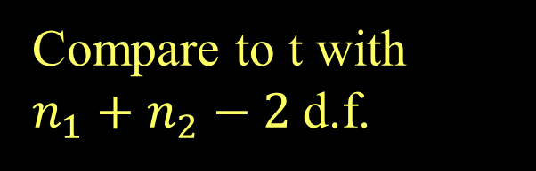
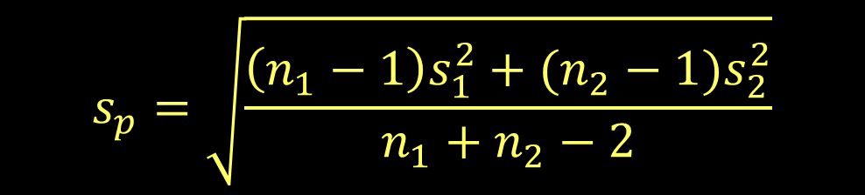

Two-sample T-test for Means
(using pooled variances)
H_{o}: μ₁ = μ₂
H_{a}: μ₁ ≠ μ₂
$$t=\frac{{\overline{y}}_{1}−{\overline{y}}_{2}}{s_{p}\sqrt{\frac{1}{n_{1}}+\frac{1}{n_{2}}}}$$
Compare to t with $n_{1}+n_{2}−2$d.f.
where:
$$s_{p}=\sqrt{\frac{\left(n_{1}−1\right)s_{1}^{2}+{(n_{2}−1)s}_{2}^{2}}{n_{1}+n_{2}−2}}$$
(pooled standard deviation)

Slide 5
R - Two-sample T-test
> t.test(Active~Sex, var.equal=TRUE, data=Pulse)
Two Sample t-test
data: Active by Sex
t = -2.8329, df = 373, p-value = 0.004863
alternative hypothesis: true difference in means is not equal to 0
95 percent confidence interval:
-8.992040 -1.623594
sample estimates:
mean in group 0 mean in group 1
84.60753 89.91534
This difference is “significant”

Slide 6
“Dummy” Predictors
We can code a categorical predictor as (0,1)
How should this be interpreted in a regression?
Example: Y = Active pulse

Slide 7
Two-sample T-test vs. Dummy Regression
> modelp=lm(Active~Sex,data=Pulse)
> summary(modelP)
Estimate Std. Error t value Pr(>|t|)
(Intercept) 84.608 1.330 63.607 < 2e-16 ***
Sex 5.308 1.874 2.833 0.00486 ** ---
Residual standard error: 18.28 on 335 degrees of freedom
Multiple R-squared: 0.02921, Adjusted R-squared: 0.02632
F-statistic: 10.08 on 1 and 335 DF, p-value: 0.001637
Mean for Males
Difference for Females
> t.test(Active~Sex,var.equal=TRUE, data=Pulse)
Two Sample t-test
data: Active by Sex
t = -2.8329, df = 373, p-value = 0.004863
alternative hypothesis: true difference in means is not equal to 0
95 percent confidence interval:
-8.992040 -1.623594
sample estimates:
mean in group 0 mean in group 1
84.60753 89.91534
t-test for significant difference
Mean for Males
Mean for Females

Slide 8
Quantitative + Indicator Predictors
Example: Y = Active pulse rate
X₁ = Resting pulse rate
X₂ = Sex (0,1)
Estimate Std. Error t value Pr(>|t|)
(Intercept) 8.01600 5.04661 1.588 0.113
Rest 1.16484 0.07511 15.508 <2e-16 Sex 2.32642 1.47471 1.578 0.116
$$\hat{Active}=8.016+1.165Rest+2.326Sex$$
How do we interpret the coefficient of sex?

Slide 9
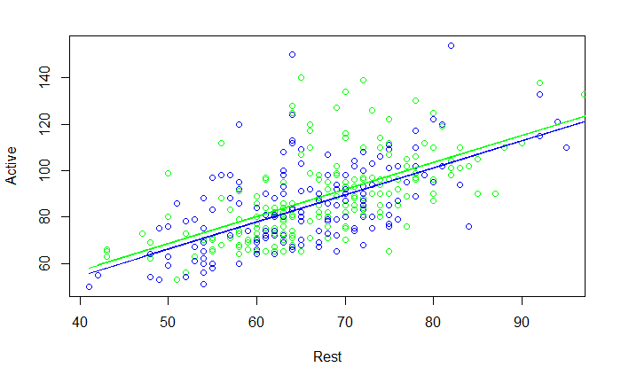
$$\hat{Active}=8.016+1.165Rest+2.326Sex$$
Same slope, different intercepts

Slide 10

Quantitative + Indicator Predictors
H_{o}: β₂ = 0
H_{a}: β₂ ≠ 0
$$\hat{Active}=8.016+1.165Rest+2.326Sex$$
Estimate Std. Error t value Pr(>|t|)
(Intercept) 8.01600 5.04661 1.588 0.113
Rest 1.16484 0.07511 15.508 <2e-16 Sex 2.32642 1.47471 1.578 0.116
$$There is not evidence to reject the null hypothesis$$
$and suggest that$β₂ ≠ 0

Slide 11
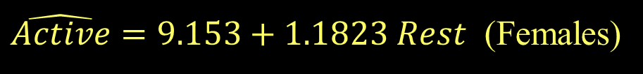
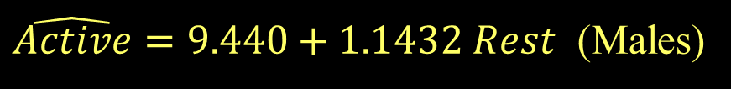
Fit Models to Subsets
> Males=subset(Pulse,Sex==0)
> modelPM=lm(Active~Rest,data=Males)
> summary(modelPM)
Estimate Std. Error t value Pr(>|t|)
(Intercept) 9.4399 7.4324 1.27 0.206
Rest 1.1432 0.1119 10.21 <2e-16 ***
$\hat{Active}=9.440+1.1432 Rest$ (Males)
> Females=subset(Pulse, Sex==1)
> modelPF=lm(Active~Rest,data=Females)
> summary(modelPF)
Estimate Std. Error t value Pr(>|t|)
(Intercept) 9.1527 7 .0198 1.304 0.194
Rest 1.1823 0.1016 11.633 < 2e-16 ***
$\hat{Active}=9.153+1.1823 Rest$ (Females)

Slide 12
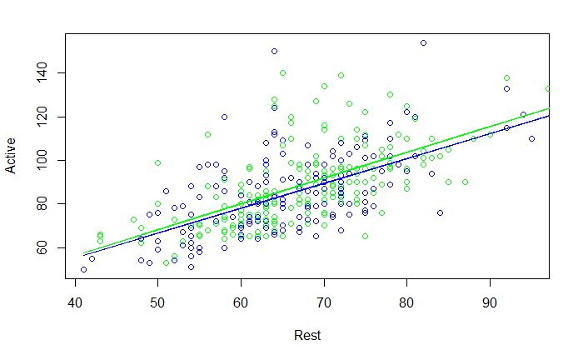
Are these lines “significantly” different?
Females
Males

Slide 13
Comparing Two Regression Lines (with a multiple regression)
Example:
Y=Active pulse
X₁= Resting pulse X₂= Sex(0,1)
Quantitative
Indicator
Interaction

Slide 14
MTB output to compare two lines
Quantitative + Indicator +Interaction
> modelPint=lm(Active~Rest+Sex+Rest*Sex,data=Pulse)
> summary(modelPint)
Estimate Std. Error t value Pr(>|t|)
(Intercept) 9.43987 7.47902 1.262 0.208
Rest 1.14319 0.11264 10.149 <2e-16 ***
Sex -0.28717 10.22830 -0.028 0.978
Rest:Sex 0.03907 0.15130 0.258 0.796
---
Residual standard error: 14.17 on 371 degrees of freedom Multiple R-squared: 0.4056, Adjusted R-squared: 0.4008
F-statistic: 84.37 on 3 and 371 DF, p-value: < 2.2e-16
$$\hat{Active}=9.440+1.1432Rest−0.287Sex+0.039Rest∗Sex$$
How does this relate to the two lines?
Substitute Sex=0 and Sex=1

Slide 15
Tests to Compare Two Regression Lines
$$Y=β_{0}+β_{1}X_{1}+β_{2}X_{2}+β_{3}X_{1}X_{2}+ε$$
Different slope?
H_{o}: β₃ = 0
H_{a}: β₃ ≠ 0
How do we test just a subset of predictors?
(t-test)
Different intercept?
H_{o}: β₂ = 0
H_{a}: β₂ ≠ 0
(t-test)
Different lines?
H_{o}: β₂ = β₃ = 0
H_{a}: β₂ ≠ 0 or β₃ ≠ 0
(???)

Slide 16
Multiple regression model
$$Y=β_{0}+β_{1}X_{1}+β_{2}X_{2}+…+β_{k}X_{k}+ε$$
We can test…
One term at a time: (t-test)
H_{o}: β_{i}=0
H_{a}: β_{i}≠0
All terms at once: (ANOVA)
H_{o}: β₁= β₂= ...=β_{k}= 0
H_{a}: Some β_{i}≠0
Is there anything in between?

Slide 17

Nested Models
Definition: If all of the predictors in Model A are also in a bigger Model B, we say that Model A is nested in Model B.
Example: $Active=β_{0}+β_{1}Rest+ ε$ is nested in
$$Active=β_{0}+β_{1}Rest+_{2}Sex+_{3}Rest∗Sex+ε$$
Test for Nested Models:
Do we really need the extra terms in Model B?
i.e. How much do they “add” to Model A?

Slide 18
Nested F-test
Basic idea:
1. Find how much “extra” variability is explained when the “new” terms being tested are added.
2. Divide by the number of new terms to get a mean square for the new part of the model.
3. Divide this mean square by the MSE for the “full” model to get an F-statistic.
4. Compare to an F-distribution to find a p-value.

Slide 19
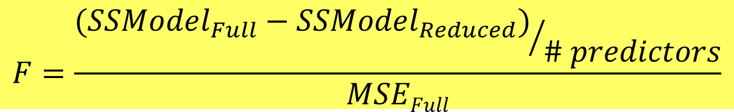
Nested F-test
Test: H_{o}: β_{i}=0 for a “subset” of predictors
H_{a}: β_{i}≠0 for some predictors in the subset
Explained by full model
Explained by reduced model
$$F=\frac{{(SSModel_{Full}−SSModel_{Reduced})}/{\# predictors}}{MSEFull}$$
#predictors tested in H₀
Based on full model
Compare to F-distribution

Slide 20
Nested F-test
$$Active =β_{0}+β1Rest+_{2}Sex+ 3RestSex +ε$$
H₀: β₂=β₃=0
H_{a}: Some β_{i}≠0
Compare mean square for the “extra” variability to the mean square error for the full model.
anova(modelP_Reduced, modelPint)
Analysis of Variance Table
Model 1: Active ~ Rest
Model 2: Active ~ Rest + Sex + Rest * Sex
Res.Df RSS Df Sum of Sq F Pr(>F)
1 373 75050
2 371 74538 2 512.14 1.2746 0.2808

